Slide 1
Introduction to Quantum Computing: From a Layperson to a Programmer in 30 Steps
Hiu-Yung Wong
https://link.springer.com/book/10.1007/978-3-030-98339-0
https://www.amazon.com/Introduction-Quantum-Computing-Layperson-Programmer/dp/3030983382
Playlist: https://www.youtube.com/watch?v=E9wd-1slbNo&list=PLnK6MrIqGXsJfcBdppW3CKJ858zR8P4eP&index=36
https://www.youtube.com/watch?v=2-Myz8CfrqE&list=PLnK6MrIqGXsJfcBdppW3CKJ858zR8P4eP&index=37
https://www.youtube.com/watch?v=QQS5il0LH1I&list=PLnK6MrIqGXsJfcBdppW3CKJ858zR8P4eP&index=39

Slide 2
Quantum Algorithm

Slide 3
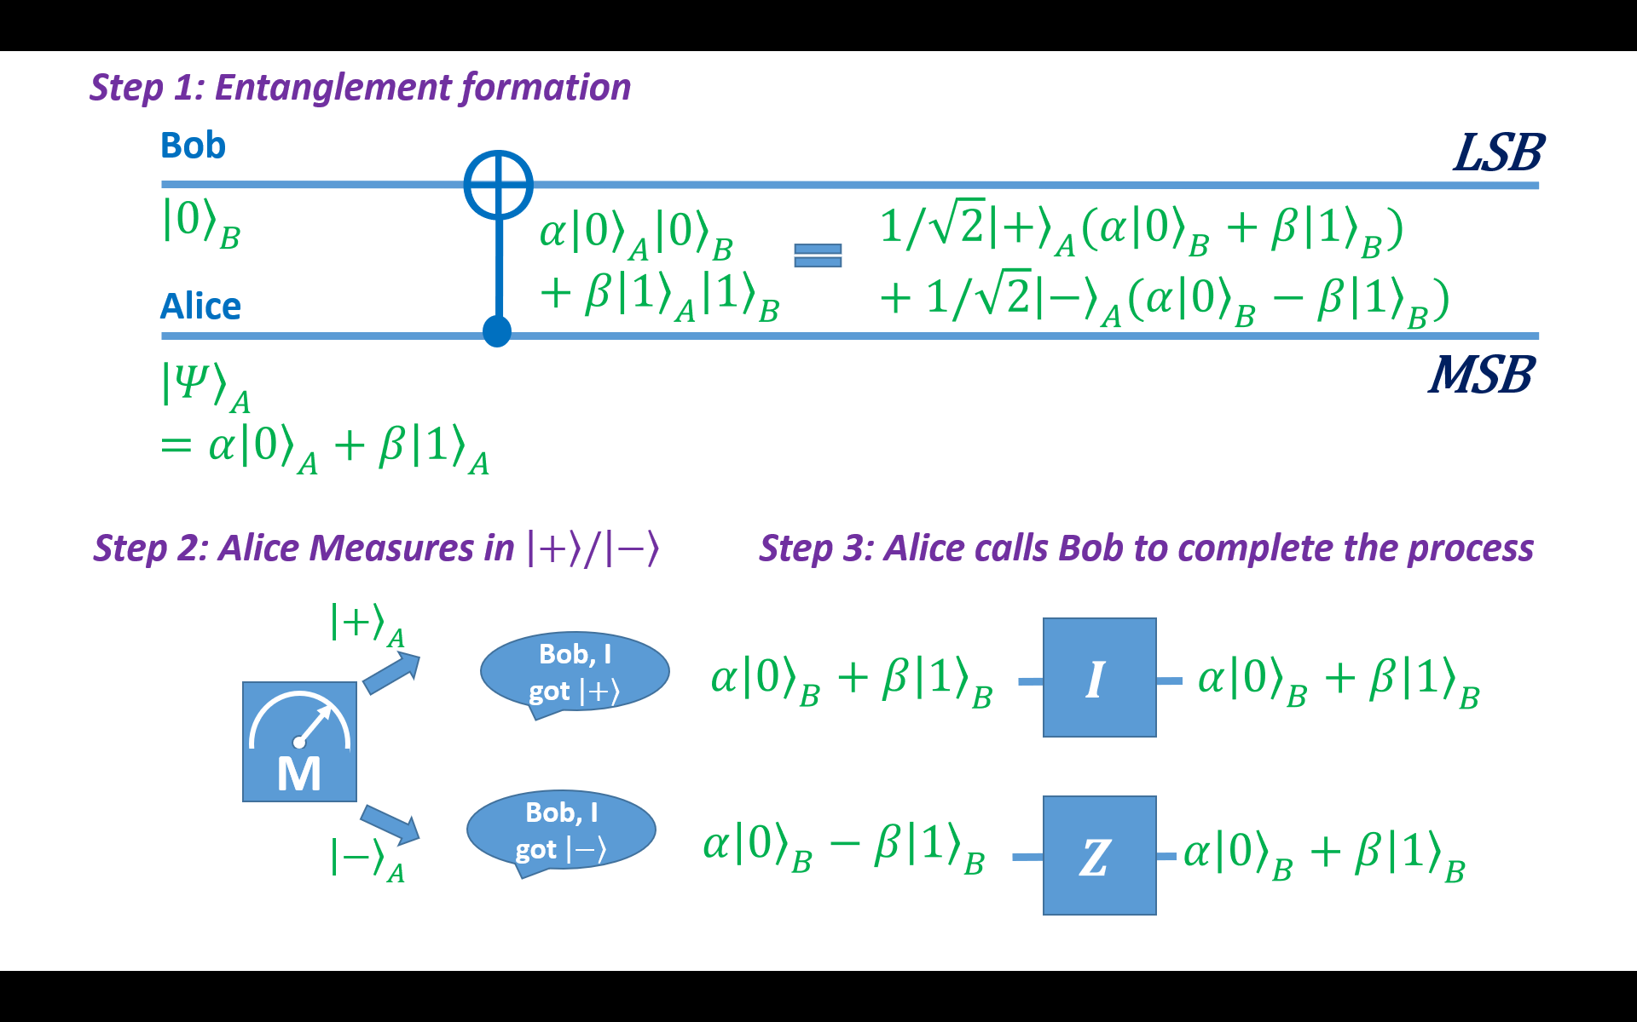
19-1
Step 1: Entanglement formation
Bob
$$⨁$$
LSB
$${\left|\left.0\right\rangle \right.}_{B}$$
$$α{\left|\left.0\right\rangle \right.}_{A}{\left|\left.0\right\rangle \right.}_{B}+β{\left|\left.1\right\rangle \right.}_{A}{\left|\left.1\right\rangle \right.}_{B}$$
$$1/\sqrt{2}{\left|\left.+\right\rangle \right.}_{A}({α\left|\left.0\right\rangle \right.}_{B}+{β\left|\left.1\right\rangle \right.}_{B})+1/\sqrt{2}{\left|\left.−\right\rangle \right.}_{A}({α\left|\left.0\right\rangle \right.}_{B}−{β\left|\left.1\right\rangle \right.}_{B})$$
Alice
$${\left|\left.Ψ\right\rangle \right.}_{A}=α{\left|\left.0\right\rangle \right.}_{A}+β{\left|\left.1\right\rangle \right.}_{A}$$
MSB
Step 2: Alice Measures in $\left|\left.+\right\rangle \right./\left|\left.−\right\rangle \right.$
Step 3: Alice calls Bob to complete the process
$${\left|\left.+\right\rangle \right.}_{A}$$
Bob, I got $\left|\left.+\right\rangle \right.$
$$I$$
$${α\left|\left.0\right\rangle \right.}_{B}+{β\left|\left.1\right\rangle \right.}_{B}$$
$${α\left|\left.0\right\rangle \right.}_{B}+{β\left|\left.1\right\rangle \right.}_{B}$$
M
Bob, I got $\left|\left.−\right\rangle \right.$
$${α\left|\left.0\right\rangle \right.}_{B}−{β\left|\left.1\right\rangle \right.}_{B}$$
$$Z$$
$${\left|\left.−\right\rangle \right.}_{A}$$
$${α\left|\left.0\right\rangle \right.}_{B}+{β\left|\left.1\right\rangle \right.}_{B}$$

Slide 4
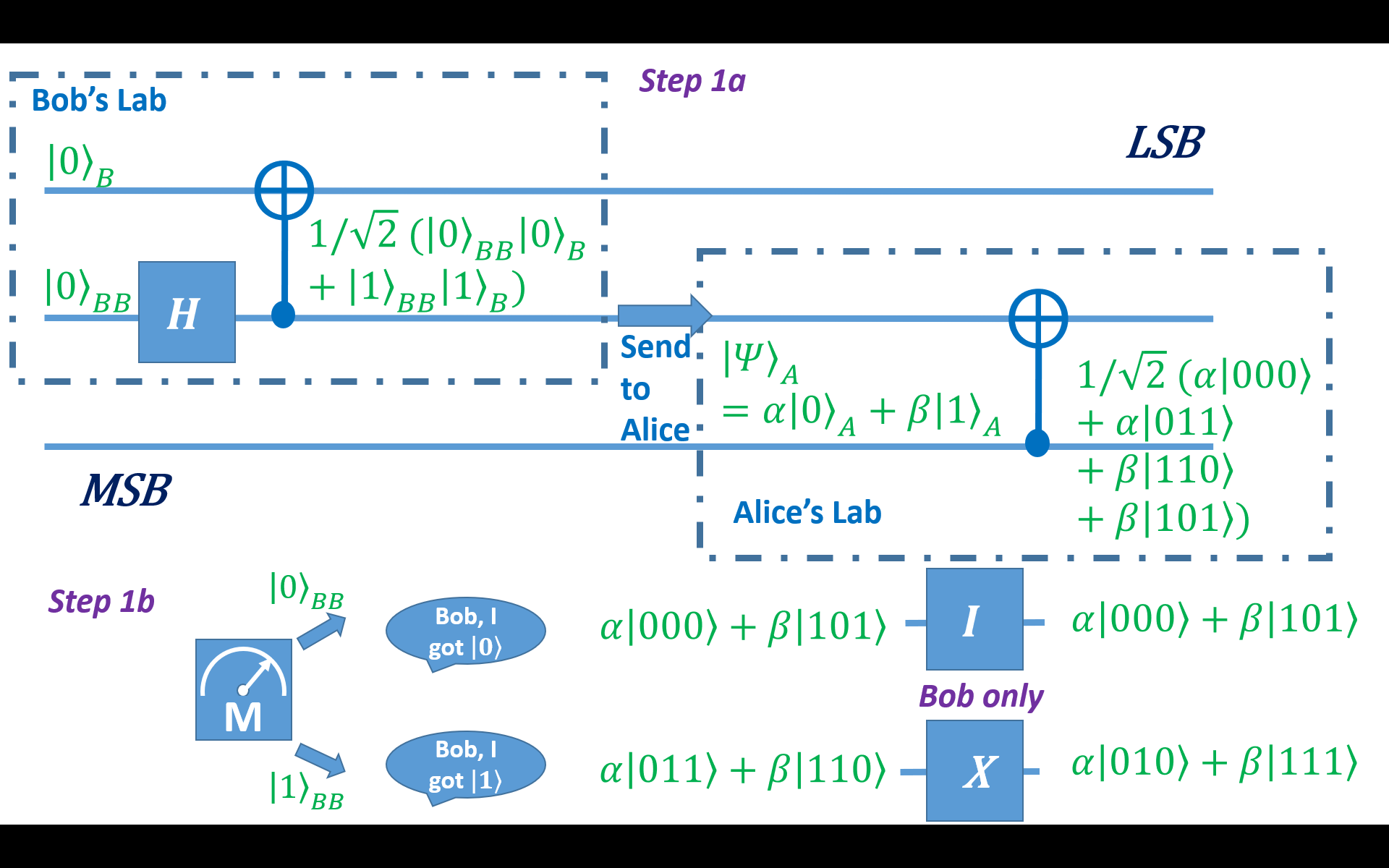
20-1
Step 1a
Bob’s Lab
To replace CNOT gate
LSB
$${\left|\left.0\right\rangle \right.}_{B}$$
$$⨁$$
$$1/\sqrt{2} ({\left|\left.0\right\rangle \right.}_{BB}{\left|\left.0\right\rangle \right.}_{B}+{\left|\left.1\right\rangle \right.}_{BB}{\left|\left.1\right\rangle \right.}_{B})$$
$${\left|\left.0\right\rangle \right.}_{BB}$$
$$H$$
$$⨁$$
Send to Alice
$${\left|\left.Ψ\right\rangle \right.}_{A}=α{\left|\left.0\right\rangle \right.}_{A}+β{\left|\left.1\right\rangle \right.}_{A}$$
$$1/\sqrt{2} (α\left|\left.000\right\rangle \right.+α\left|\left.011\right\rangle \right.+β\left|\left.110\right\rangle \right.+β\left|\left.101\right\rangle \right.)$$
MSB
Alice’s Lab
$${\left|\left.0\right\rangle \right.}_{BB}$$
$$I$$
Step 1b
Bob, I got $\left|\left.0\right\rangle \right.$
$$α\left|\left.000\right\rangle \right.+β\left|\left.101\right\rangle \right.$$
$$α\left|\left.000\right\rangle \right.+β\left|\left.101\right\rangle \right.$$
M
Bob only
Bob, I got $\left|\left.1\right\rangle \right.$
X
$$α\left|\left.010\right\rangle \right.+β\left|\left.111\right\rangle \right.$$
$$α\left|\left.011\right\rangle \right.+β\left|\left.110\right\rangle \right.$$
$${\left|\left.1\right\rangle \right.}_{BB}$$

Slide 5

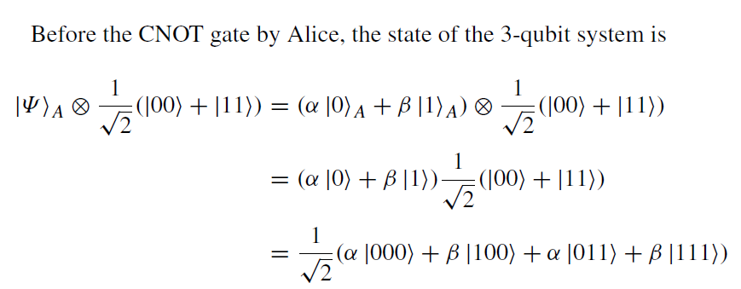


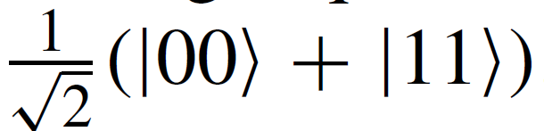
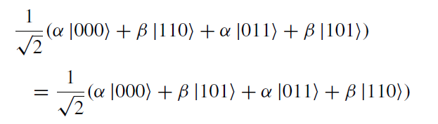
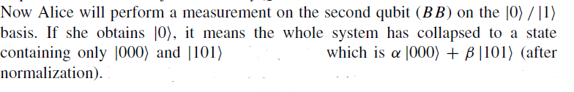

Quantum Teleportation – More Realistic
Alice Lab
Bobs Lab
He then applies H ⊗ I to it.
We know that H, the Hadamard gate, will create a superposition of the basis states.
Therefore, it becomes
After that, the CNOT gate is applied.
Measurement 1
Measurement 2

Slide 6
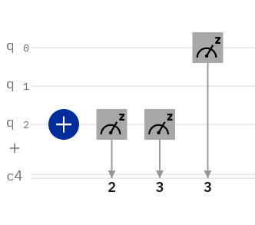
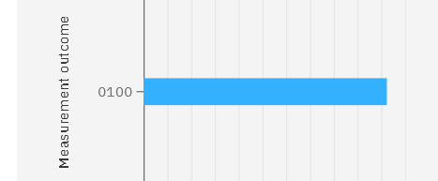
IBM Qiskit – Teleportation - Measurement
Measurement can be assigned to any position in the classical qubit
Those not measure will be zero
New measurement overwrite the previous measurement if store in the same qubit

Slide 7
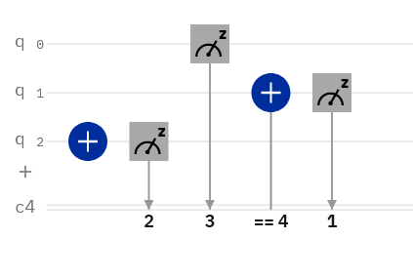
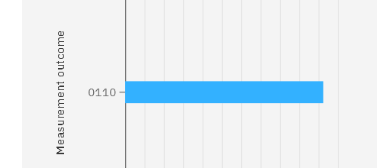
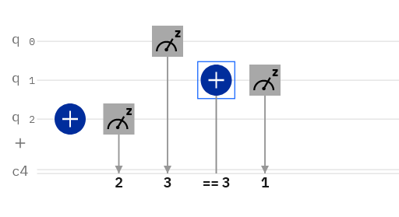
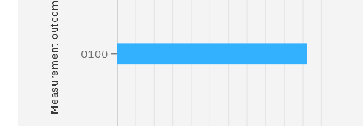
Measurement in Qiskit

Slide 8
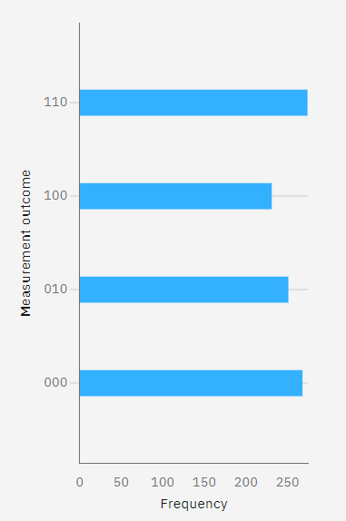
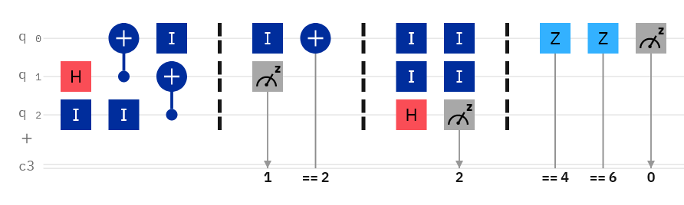
IBM Qiskit - Teleportation
Step 1a
Step 1b
Step 2
Step 3
Bob (B)
Ancillary (BB)
Alice (A)

Slide 9
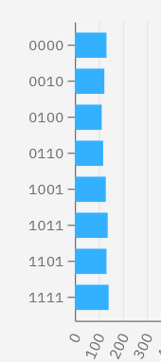
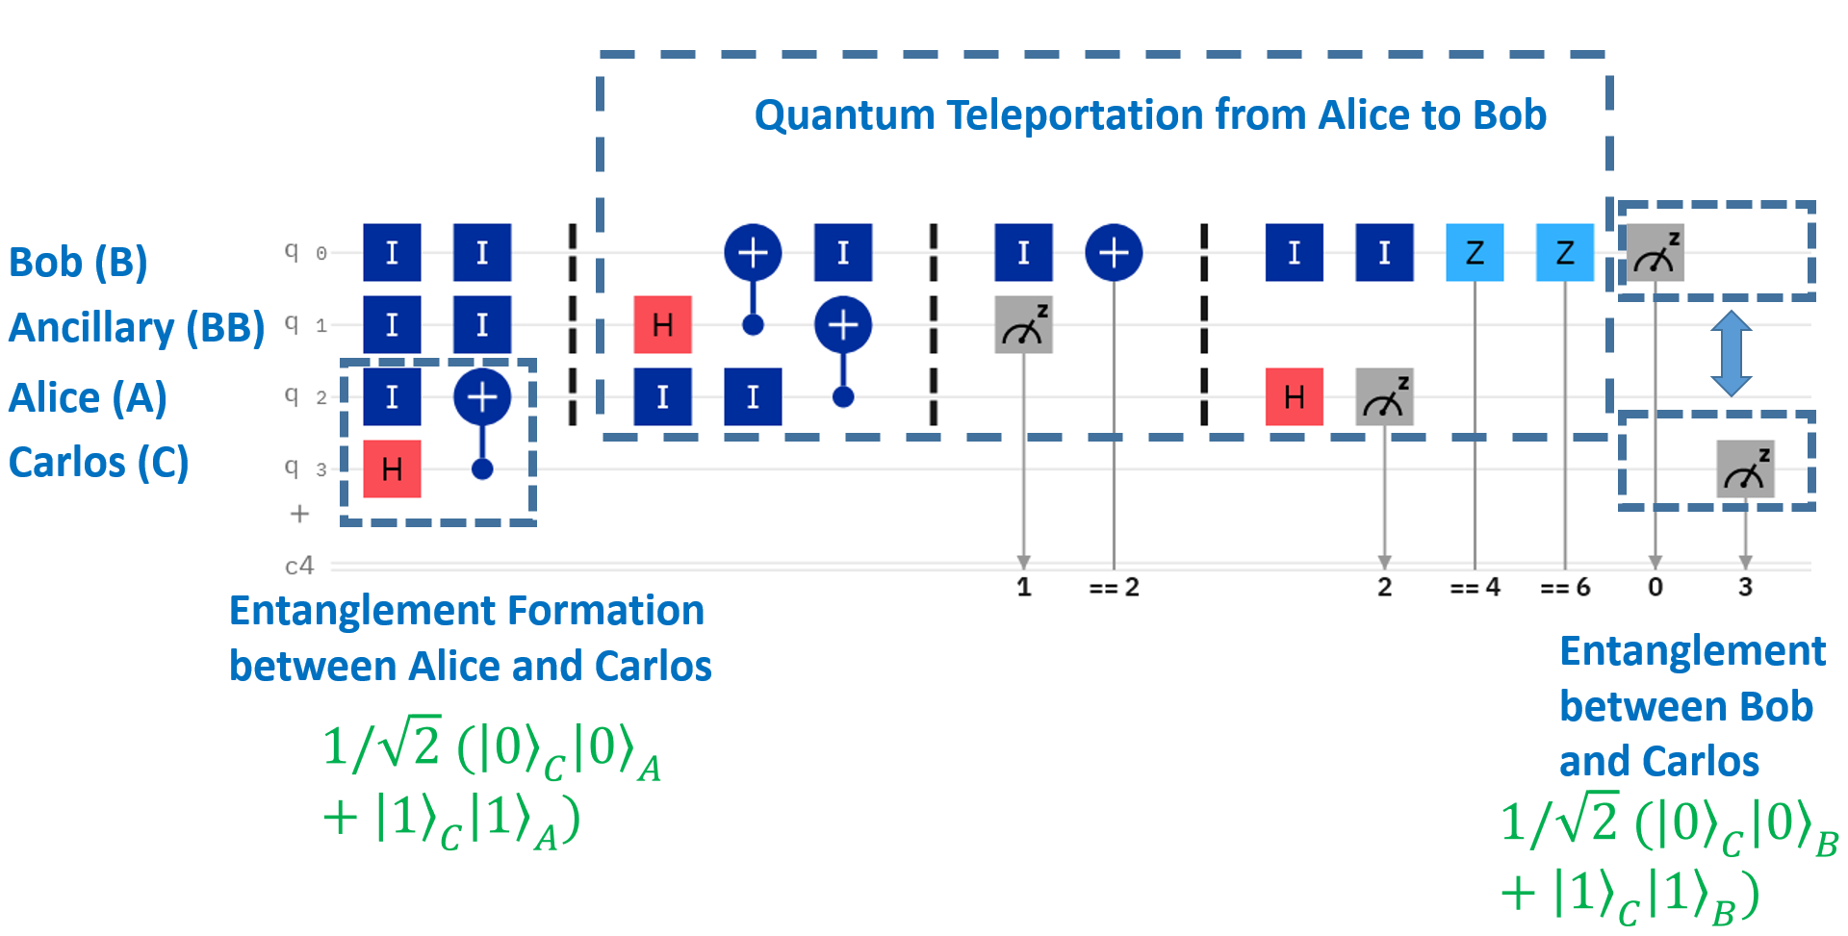
Entanglement Swapping (4-qubit)

Slide 10
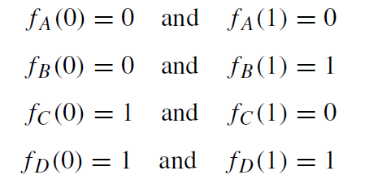
Deutsch’s Problem
Finding if a function balanced or constant?
Boolean function:
f : {0, 1} → {0, 1}
Constant
balanced
balanced
Constant
Classically, 2 computation, f(0) and f(1) QC, do this in 1 computation.

Slide 11
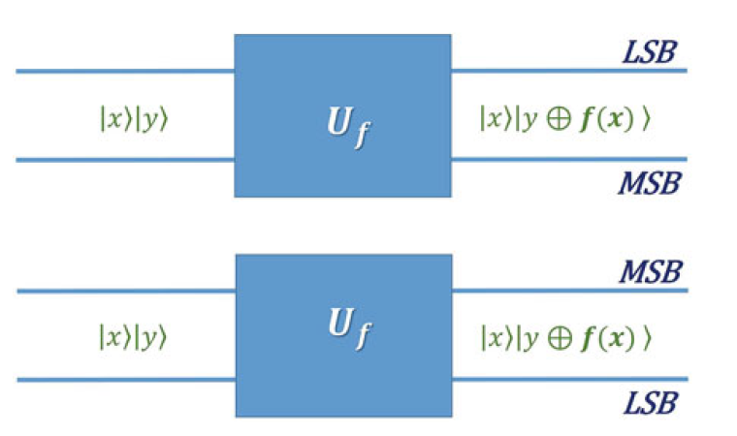

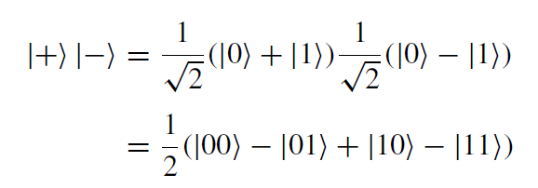
Deutsch’s Algorithm (overview)
Step 0: Create a Quantum Oracle
Step 1: Create a Superposition Input

Slide 12
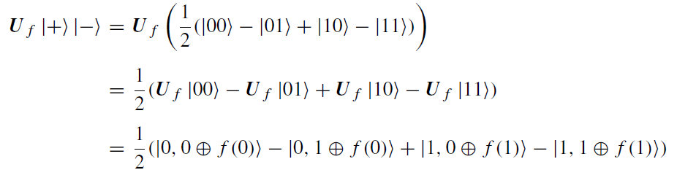
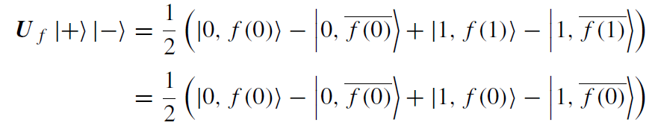
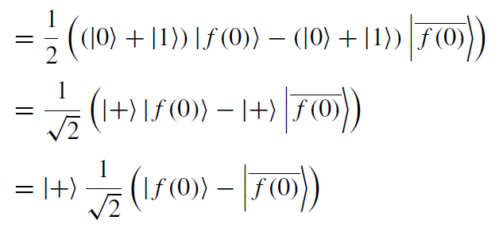
Step 2: Evaluate Using the Quantum Oracle
Step 3: Measure on the Right Basis to Get the Answer (e.g. if it is constant)

